Slide 1

ORACLE ERP Services

Slide 2
Agenda
SumPositive Offshore Overview
ERP Modules Coverage
ERP Competencies
Onshore / Offshore Model
Ticketing System Options
Rate Card
Select ERP Staff

Slide 3




About SumPositive Offshore
Offshore offices in:
Hyderabad , India (1 Corporate Office , 2 Development Centers)
Offshore India Staff of 150 +
Multiple technology Implementation with focus on Oracle Technologies
24/7 (round the clock) active office hours

Slide 4



Hours of Operation
Hours of Operation
Europe Support Timings:
2. USA Support Timings
IST | GMT
11.30 AM 8.30 PM | 6.00 AM 3.00 PM
Note: We can provide extended hour support based
on Timex client requirement .We have staff in other regions that we would leverage for 24/7 coverage.
IST | EST | PST
5.30 PM 2.30 AM | 8.00 AM 5.00 PM | 5.00 AM 2.00 PM

Slide 5
Modules / Business Scope of Skills Covered
Sales
Sales
Order Capture
Portfolio/Project Management
Contracts
Costing
Procurement
Sourcing
Procurement
Planning & Budgeting
Financials
Billing
Reporting
Punch-outs
Oracle Supplier Network
Planning
Budgeting
Forecasting
Integration
General Ledger
HCM
Payabes
Receivables
Cash Management
Fixed Assets
Travel & Expenses
Fulfillment
Global Human Resources
Taleo BE
Workforce Rewards
Workforce Management
Manufacturing
Inventory
Bill of Materials
Cost Management
Work in Progress
Advanced Supply chain Planning
Sourcing
Quality
EU Taxation
US Taxation

Slide 6

Technical Services Offered
Development Services
Technical Areas
Our Technical Development services include the following:
Solution Design
Technical Design Document
Development
Unit Testing
Installation Document
Our implementation services include the following:
Interfaces/Conversions
Forms/Reports Development
Workflow Development
OAF Pages Development
XML Reports
Customizations
Among others

Slide 7
Services Offered
Support Services
Imlementation/Delivery Services
Our support services include the following:
Level I & II support for all ERP Modules
Level III – Oracle Support Coordination
Root Cause Analysis build
Oracle quarterly updates Support
Developing customized test scripts
Selenium based test automation
Frequently used HOW TO documents build
New Features introduction with remote training sessions and HOW TO document
Our implementation services include the following:
AIM/OUM Methodology
Develop Customized User Guides
Develop Implementation Test Scripts
Run pre-UAT/CRP Test Scripts and identify issues
Resolve issues
Conduct End User Training Sessions remotely

Slide 8
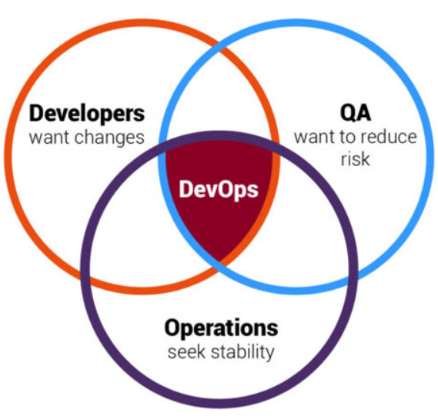
DevOps Offering
Support Services
Imlementation/Delivery Services
API :
Source and target test queries
Connections to data stores
Tests associated with an execution suite
New staging tables from various data connections
Custom flow controls based on run results
Automation
Tools selection
Continuous Integration
Continuous Infrastructure
Continuous deployment/delivery
Implementation
Execute DevOps flawlessly.
Find and fix errors in real-time
Agile Development
API data solution for continuous data testing.
DevOps process automation service.
DevOps Implementation Services.

Slide 9
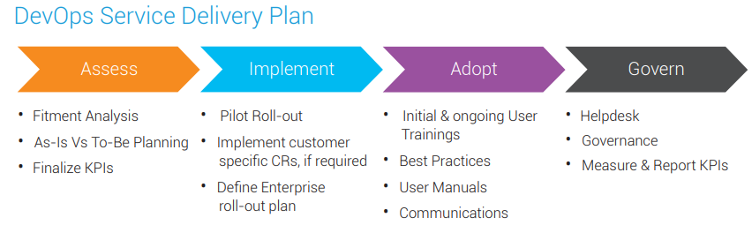
DevOps Offering
Service delivery
Imlementation/Delivery Services
Assessment
Implementation
Adopt
Governance
Progressive model-based test
Web applications
Desktop testing
Mobile applications (Andriod)

Slide 10
DevOps Team
Program Manager : - Ravi kumar
Ravi
Project Lead Cloud & DevOps–Rama Krishna
Technical consultant – Samantha Changal
Overall 10+ years of experience in developing and maintaining Enterprise applications with Agile
Managed End-to-End solution with Ansible for configuration management – IaaS, Expertise tools Jenkins, SCM, Artifactory, Python, Coordinator Kubernetes, Openshift, Google Anthos.
Frameworks like Spring Boot, Netflix OSS, Angular.
Industry Telecom, Health Care, Banking & Finance
Technical consultant with diverse operational experience in both IT Digital transformation and Engineering.
Over 15+ experience Design, build and configure applications to meet business process and application requirements in a large digital transformation program.
Development of IT Application core project management tools & integrating business applications and configuring Productivity tools.

Slide 11
ERP Competencies
Customizations
New Module Implementations
Interfaces
Conversions
Extensions
Database Support
Financial Reporting Studio //
SmartView
Oracle Visual Builder
OTBI Analytics
APEX Development
BI Publisher
Hyperion Budgeting/Planning

Slide 12





Oversight / Coordination Model
On behalf of
Client Partner
Manufacturing Functional Team
Interface Developers
Reports Developers
EU Taxation Functional Team
Workflow Developers
Forms Developers
PBCS Team
Client IT Applications Manager
We act as an extension of your team.
Provides service oversight, client advocacy & planning.
Client Business Analysts (Optional)

Slide 13







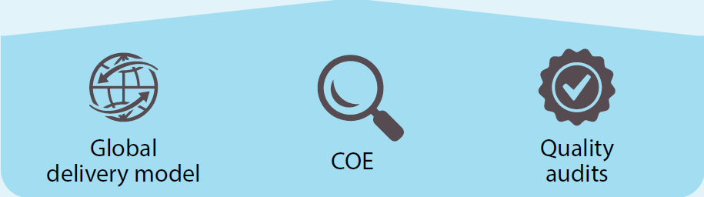
Ticketing Process – Client Managed
❶
❻
❽
Ticketing System
automatically sends updates
Client Email
Information Updated
Ticket Resolved
Client
❺
❷
Ticket Created
(Auto/Manual)
❸
❹
❼
SumPositive
Resource
Assigned
Resource
Communication
Issue
resolved

Slide 14
Ticketing Process – Client Managed
All our employees will have Timex Email addresses.
Our employees will use Timex email address for all client/external communications related to Project.
Timex may employee an onsite Business Analyst and will work with our employees.
We will assign our Client Partner for Timex who will manage all logistical relationship.
We will use Timex Email addresses to login to client managed ticketing systems such as:
Jira Cloud
Remedy On Demand
Manage Engine
Zoho Service Desk

Slide 15
Resources
We already have key resources immediately to get started .
Typical onboarding time for new resources is 3-4 weeks.

Slide 16
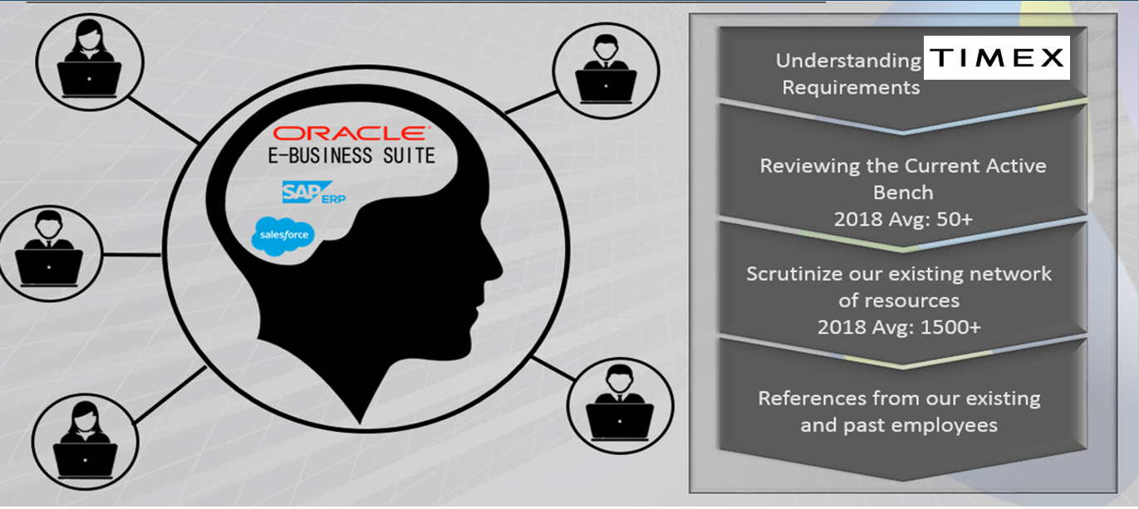
Staffing / Scaling approach

Slide 17

Selected ERP
Cloud Staff

Slide 18
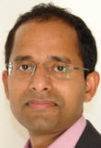
Oracle ERP : Delivery Lead and Enterprise Applications Architect (PPM)
Ravi Vadlamudi
Global
Ravi is a PPM/Finance/SCM Solution Architect with over 22 years of experience in implementations of large multi-lingual /global engagements. He has architected and designed solutions for complex business problems for medium to large complex implementations for over 15 years.
ERP Cloud Engagements: 5
E-Business Suite Engagements: 25
Industry Sectors
Industrial Services
Manufacturing
Logistics
Insurance
Information Technology
Implementation & Support Expertise
ERP Cloud R11,12 & 13
E-Business Suite
Work Experience
News Industry: Solution architect for a full life cycle implementation of ERP Cloud Financials in a year long project. Key architect for Revenue recognition, Multi-currency and Global Consolidation. Part of the team in building numerous integration points between Oracle ERP Cloud and Salesforce.com.
Bio-Tech Industry: Key architect of the Costing and OTL implementation within PPM Cloud Suite, along with Financials. Was part of 2 separate projects.
Finance Industry: Implemented Financials Cloud for a major NYC client and provided support for a significant period.
Multiple Industries: Ebusiness Suite: Worked on over 26 E-Business Suite projects over a period of 18 years.
Awards and Certifications
ERP Cloud – General Ledger Certified
ERP Cloud – Accounts Receivable Certified
ERP Cloud – Support Certified
Ebusiness Suite – Financials Implementor
PMI – Project Management Professional
3 Times speaker in Oracle Collaborate
Oracle Domain Expertise
Oracle PPM Cloud, Oracle Financials Cloud & Oracle SCM Cloud
Oracle Ebusiness Suite : Projects, Financials & Manufacturing (Discrete & Process)

Slide 19
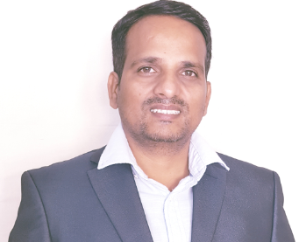
Oracle EBS & Fusion : Enterprise Architect - SaaS & PaaS
Amar Nath
Hyderabad
Over 15+ years of experience in Technology Management, implementing business & IT strategy, process, delivery and people management.
Hands-on Architect in End to End Implementations in Oracle EBS engagements including Implementation, Consulting and Support of Oracle EBS.
Oracle Fusion SaaS & PaaS architect In implementation and integrations in co-existence models.
SME in providing multi system environments integrations and building PaaS solutions
Having more than 14 ERP implementation, rollouts, enhancements and support projects across the geo locations
Involved in 6 ERP Cloud projects
Industry Sectors
Manufacturing
Supply Chain Management
Logistics
Cloud & Business Intelligence
Implementation & Support Expertise
Oracle EBS
Oracle ERP Cloud
SaaS & PaaS
Integrations
BI
Work Experience
ERP Cloud SaaS: Worked as an implementation Architect across industries for ERP cloud projects. Defining the Cloud ERP migration strategy, Phase wise Cloud migration from legacy using co existence models. Working with business to gather requirements and fit-gap-map to Fusion ERP cloud applications.
ERP Cloud PaaS: Enable PaaS for customer based on the need, Architect PaaS solutions as multi environment models using JCS, SOACS, DBCS, ICS, VBCS, BICS and Custom integrations using SOAP and REST apis.
Provided custom ADF applications where needed using PaaS JCS environment
Oracle EBS: worked as Enterprise Architect in various implementations across the industries. SME in Manufacturing and distribution modules as Techno-Functional. Hands – on EBS Technical expert with functional and integrations.
Upgrade experience from early versions to latest versions. Starting from 10.7 11i and 11i to R12.
Integrations: provided Architect solutions to integrate ERP applications with legacy applications. Using SOA, OSB and ICS in fusion cloud.
Awards and Certifications
Oracle Service Oriented Architecture Infrastructure Implementation Certified Expert(SOA)
Oracle Certified Associate(PL/SQL)
Green Belt Lean Six Sigma Methodology
Certification in Supply Chain Management(CPSCM)
Oracle Domain Expertise
EBS : Inventory, Purchasing, Oracle Payables, Bills of Material, WIP, Configurator, Order Management, Receivables, QA
Fusion (SaaS): Manufacturing, Order Management, Cloud R13 Cloud Implementation
Oracle PaaS: DBCS, JCS, ICS, BICS,VBCS, SOACS

Slide 20

Client Portfolio
Overview of Clients

Slide 21

Customer Showcase: Leading Watch manufacturer in USA
SumPositve Offering:
SumPositve offshore team has been engaged for the last 5 years .SumPositive provided support and implementation services to the client on new project rollouts and support of existing Technical implementation for EBS R12:
Bills Of Material, WIP, Costing, Order Management and Purchasing
Vendor Portal Integration ( Custom application and Integration with EBS)
SCM Enhancements
Services Provided:
Support and enhancement of existing Modules in Oracle eBS
New RICE development for production schedule and purchasing forecasting and budgeting
Complete custom solutions for Vendor portal application
Analysis and Design for Demantra Implementation
Overview:
Customer is leading American Watch manufacturing company. Customer needed support in new implementations and existing Rollout for USA and Philippines manufacturing plant.

Slide 22
Customer Showcase: Leading furniture manufacturer in Europe & USA
SumPositve Offering:
SumPositive consultants provides on going project support for EBS R12 Configurator implementation:
Bills Of Material, WIP, Costing, Order Management and Purchasing
Oracle configurator model building and testing
Services on-going:
Cerate new bills and Models in EBS
Created interfaces to import the bills and Models from third party applications
Create testing files for new Models getting created
Testing across the instances and across the product scenarios
Support on-going production issues
Overview:
Customer is a design firm that produces office systems, seating, files and storage, tables and desks, textiles and accessories for the office, home, and higher education settings.

Slide 23


Customer Showcase: Leading communication company in Qatar
Overview:
Customer is leading telecom company in Qatar. They have presence across the gulf countries.
Implementation of Sales Cloud, CPQ modules.
SumPositive Offering:
SumPositive consultants implemented Oracle Sales Cloud & CPQ:
Mobile and CRM Desktop
Customer Management
Manage interactions
Sales Campaigns
Lead Management
Opportunity Management
References and Competitors
Products and Sales Catalogs
Forecasting
Opportunities: 55,000
Customers: 16,000
Leads: 35,000
Activities: 2,000

Slide 24

Customer Showcase: Industrial Services Company
Overview:
Client is a global Industrial Services Company with Oracle eBusiness Suite R12.1.3. Implementation was to bring Oracle Sales Cloud and customer integration with Oracle E-Business.
SumPositive Offering:
SumPositive consultants implemented Oracle Sales Cloud:
360° Customer View
Product Recommendations
Sales Coach
Sales Lightbox
Lead and Opportunity Assessment
Call Report app
Team Calendar
Task Notification
Customers: 3,500
Sales Users: 120

Slide 25
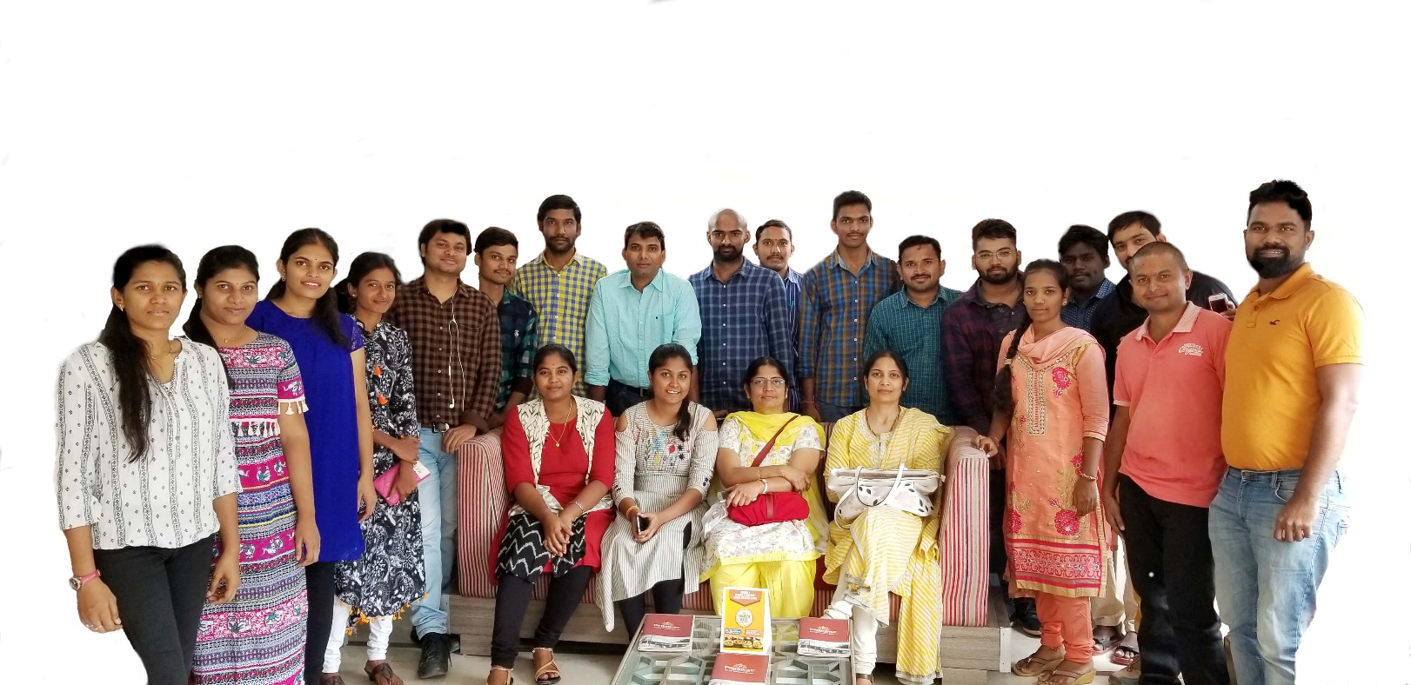
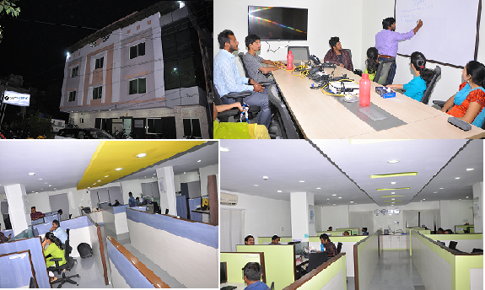
Thank you!

